Slide 1
TRiO Pre-College Programs
The redesigned SAT…Getting STARTED

Slide 2
Why is the SAT Important?
Measures College Readiness
Utilized for Admissions
Financial Aid Impact
Notes:
The SAT is a college admissions exam that measures college success skills—the critical thinking and reasoning skills in reading, math and, writing—that are necessary for academic success in college.

Slide 3
Using PSAT Scores to Prepare
Do I have a College Board Account?
Do I have a Khan Academy Account?

Slide 4
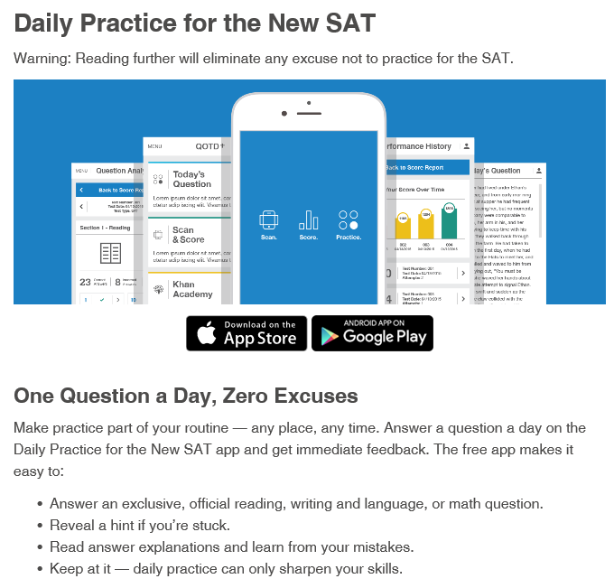
Let’s get prepared!
Learn more about the Daily Practice App at:
https://collegereadiness.collegeboard.org/sat/practice/daily-practice-app
If you do not have a phone with app capabilities, all of this is available to work with online:
https://collegereadiness.collegeboard.org/sat
Take practice in parts online: Sample Reading Questions https://collegereadiness.collegeboard.org/samplequestions/reading Sample Writing/Language Questions https://collegereadiness.collegeboard.org/sample-questions/writing-language Sample Math Questions https://collegereadiness.collegeboard.org/sample-questions/math Sample Writing https://collegereadiness.collegeboard.org/sample-questions/essay

Slide 5
Getting PSAT Scores on College Board: 1) The PSAT registration sheet asked you to give an email. THOSE WHO DID should have received an email from College Board, “PSAT SCORES” on January 7th. The email links you to College Board. You need to sign in or sign up at College Board. Be sure to use the same email address from where the linking email was sent to you. 2) If you know you did not put an email down on the PSAT registration, and have not received an email from College board, you can still sign up on the College board site, but likely your scores will not yet be there. A blue bar comes up with a help number 1-866-433-7728. You could try this on your own. If things don’t link today we will still support you to get on Khan diagnostics, which will be just as good!

Slide 6
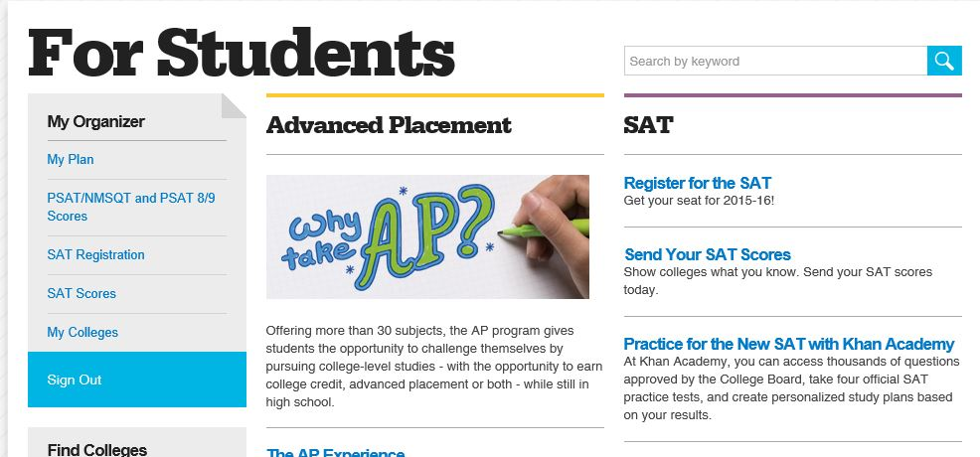
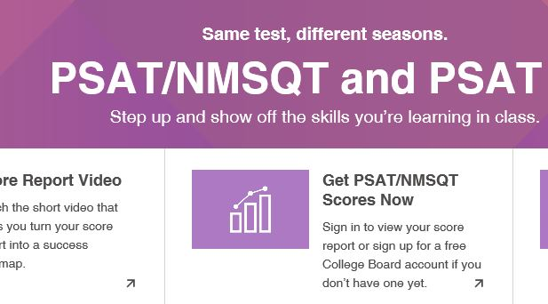
Go to College Board https://www.collegeboard.org Sign in or Sign up Click on PSAT/NMSQT to get your scores! Review right online. We will review together. * A score in the yellow says you are approaching a benchmark for college readiness. Green means you are on track for college readiness. Red means you still need to strengthen skills.

Slide 7
Connected to the Daily Practice
App and online.
Benefits of Khan:
How to videos
Identifies and provides specific
practice for weaker areas after
taking practice quizzes.
(By level 1-2-3-4)
Full online as well as print out tests.
https://www.khanacademy.org/sat

Slide 8
Where are you at with KHAN SAT Prep?
Taken all 4 diagnostic quizzes in math
Taken all 4 diagnostic quizzes in reading and writing
Taken at least one diagnostic quiz in either area
Not yet completed a diagnostic quiz
Diagnostic quizzes are worth your time. Once completed Khan Academy will start to individualize your test prep needs. (Move 2’s to 3’s and 3’s to 4’s!)
There is also possibility to connect PSAT scores as well.
ARE YOU JUST GETTING STARTED?
NO PROBLEM!

Slide 9
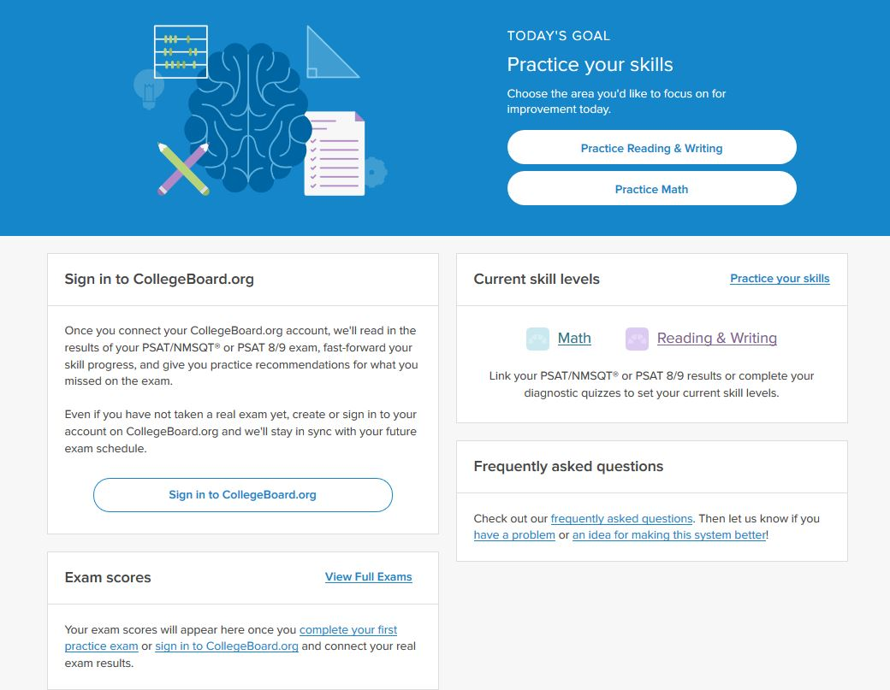
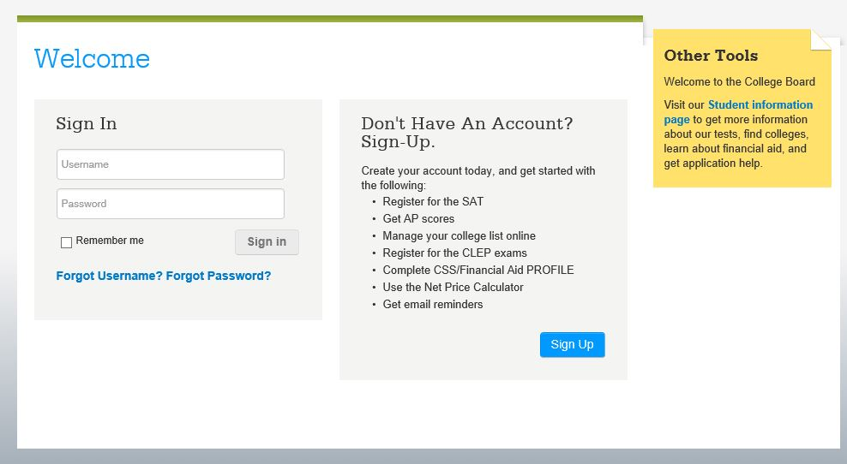
Sign into Khan Academy then
Click Sign in to College Board
(We were just there so you may
already be signed in.)
The two sites link, and your personalized plan is created.

Slide 10
What now that my PSAT Results are linked to Khan Academy? -You will see tabs and practice areas for the three main tests: Reading, Writing and Language, and Math. -Khan will integrate your PSAT score and rate your skill level in subcategories for each subject. Ratings are from 1-4, with four being the highest. (Lower scores are written lightly, higher scores are bolder.)

Slide 11
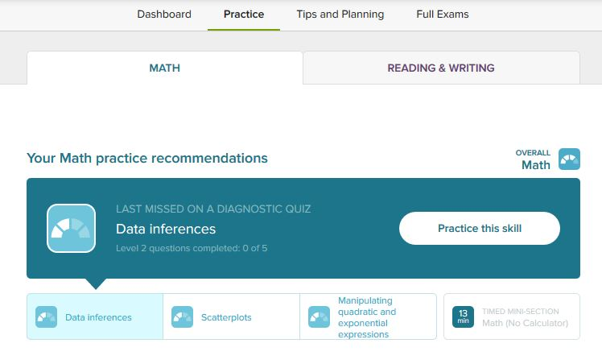
Once you take the Khan diagnostics, it will start to give you automatic recommendations
on what you need to work on. You can scroll down to see your 1-2-3-or 4 ratings in terms
of all the skills you would like to improve.

Slide 12
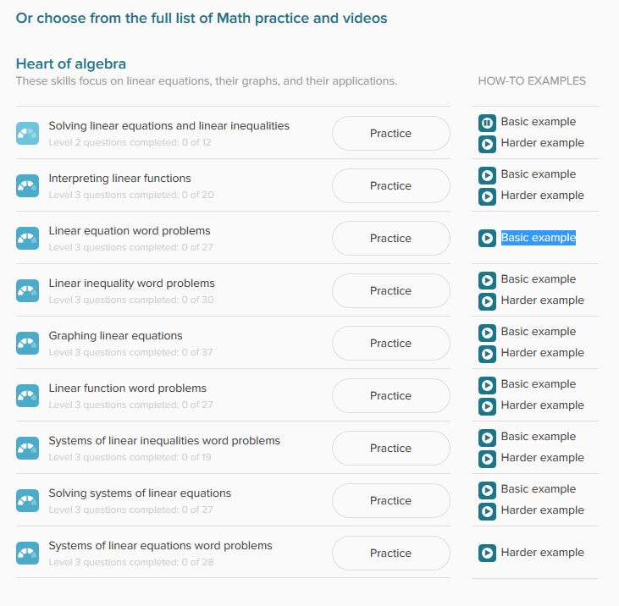
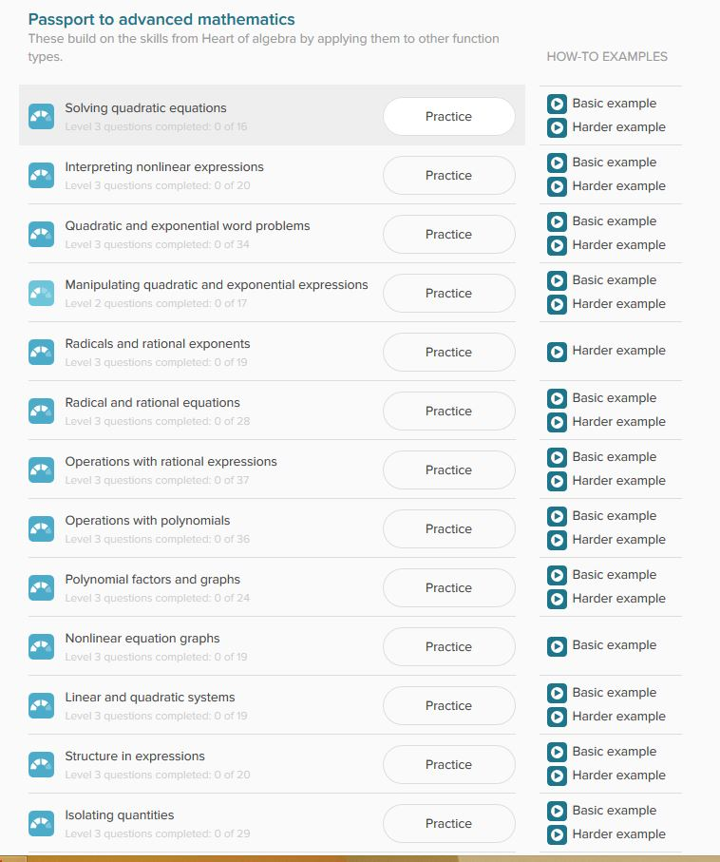
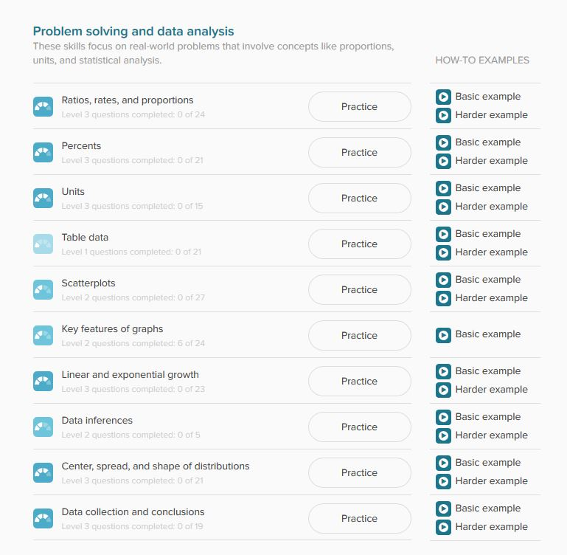
Example: 43 Areas. The great thing about the rating system is you only need to work on lower levels.

Slide 13
You will have all the tools, Now…The TEST ITSELF! What are the areas of emphasis as I practice and prepare?

Slide 14
Test Content and Question Overview
 | Content Emphasis-Features | Question Type- Expectation | # - Time Allotted
Reading Test | Command of Evidence Find evidence in a passage (or pair of passages) that best supports the answer. Identify how authors use evidence to support their claims. Find a relationship between an informational graphic (graph, table, picture) and the passage with which it’s paired. Words in Context Focus on important, widely used words and phrases. Use context clues in a passage to figure out which meaning of a word or phrase is being used. Decide how an author’s word choice shapes meaning, style, and tone. Analysis in History/Social Studies and in Science Includes passages in the fields of U.S. and World literature, history, social studies, and science. Questions may ask you to: Examine hypotheses Interpret data Consider implications | Passage-based, 500-700 words each, multiple choice, line specific. Passages range in difficulty from what is expected in 9th grade all the way to college-entry level courses. Correct answers are derived from only what is stated or implied, not from prior knowledge that a student has about the topic. SHOW HOW WELL YOU UNDERSTAND WHAT YOU READ | 1 Section 52 questions in 65 minutes
Notes:
This is a chart of test content and question types. There will be only two item types for math (Multiple-Choice and Student-Produced Responses) and will contain Algebra II content. The percentages of the test that cover each of the content areas will shift slightly, but this is not indicated on the chart. For example, Data and Statistics items will receive greater emphasis.

Slide 15
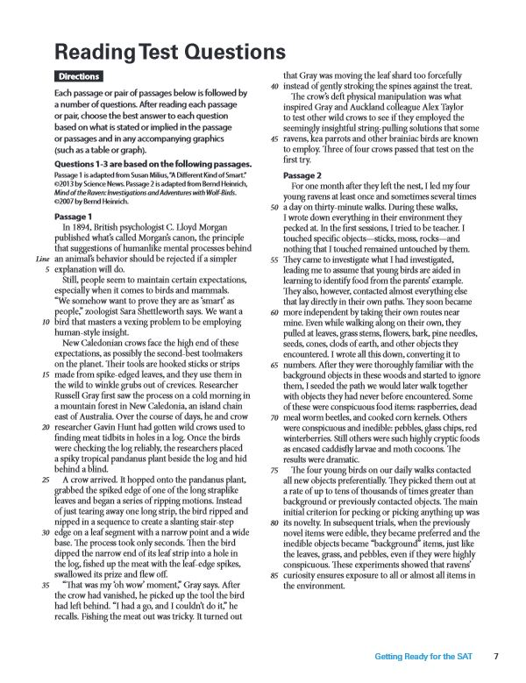
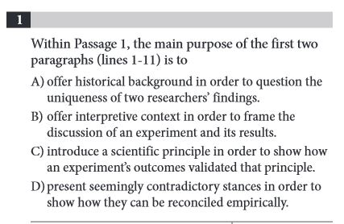
Take a look:
Extensive passages
Often line specific
Evidence based
https://collegereadiness.collegeboard.org/samplequestions/reading

Slide 16
 | Content Emphasis-Features | Question Type- Expectation | # - Time Allotted
Writing and Language Test | Repeat from Reading: Command of Evidence Words in Context Analysis in History/Social Studies and in Science In addition: Expression of Ideas Some questions ask about a passage’s organization and its impact. For instance, you will be asked which words or structural changes improve how well it makes its point and how well its sentences and paragraphs work together. Standard English Conventions This is about the building blocks of writing: sentence structure, usage, and punctuation. You’ll be asked to change words, clauses, sentences, and punctuation. Some topics covered include verb tense, parallel construction, subject-verb agreement, and comma use. | Passage-based, 400-450 words each, multiple choice, and line specific. Correct answers are derived from a student successfully playing the role of editor. SHOW HOW YOU CAN EDIT AND REVISE TEXTS | 1 Section 44 questions in 35 minutes

Slide 17
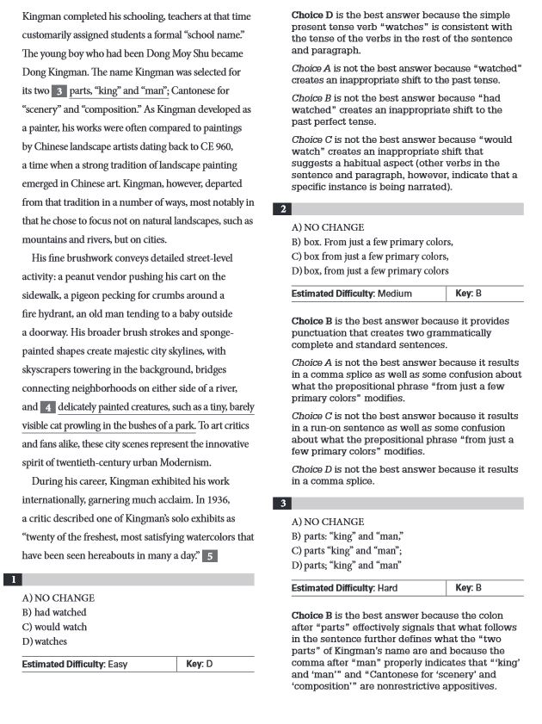
Take a look:
Extensive passages
Often line specific
Author Driven
https://collegereadiness.collegeboard.org/sample-questions/writing-language

Slide 18
 | Content Emphasis-Features | Question Type- Expectation | # - Time Allotted
Math Test | Fluency Carry out procedures flexibly, accurately, efficiently, and strategically. Solve problems quickly by identifying and using the most efficient solution approaches. This might involve solving a problem by inspection, finding a shortcut, or reorganizing information. Conceptual Understanding Demonstrate grasp of math concepts, operations, and relations. You might be asked to make connections between properties of linear equations, their graphs, and the contexts they represent. Applications Real-world problems ask you to analyze a situation, determine the essential elements required to solve the problem, represent the problem mathematically, and carry out a solution. The Test measures four areas: Heart of Algebra Problem Solving and Data Analysis Passport to Advanced Math Additional Topics in Math (covering relevant concepts learned in high school math, such as the Pythagorean theorem) | Calculator Work Focus is on complex modeling and reasoning, and your calculator can save you time with multiple choice. Non-Calculator Work The No Calculator portion of the test makes it easier to assess your math fluency. It also tests well-learned technique and number sense. Grid-In Questions 22 percent of questions are student-produced response, also known as grid-ins. Instead of choosing a correct answer from a list of options, you’ll need to solve problems and enter your answers in the grids provided on the answer sheet. SHOW HOW YOU CAN PROBLEM- SOLVE AND USE APPROPRIATE APPROCHES AND TOOLS | 2 Sections 38 w/calculator in 55 minutes (8 grid in) 20 no calculator in 25 minutes (5 grid in)

Slide 19
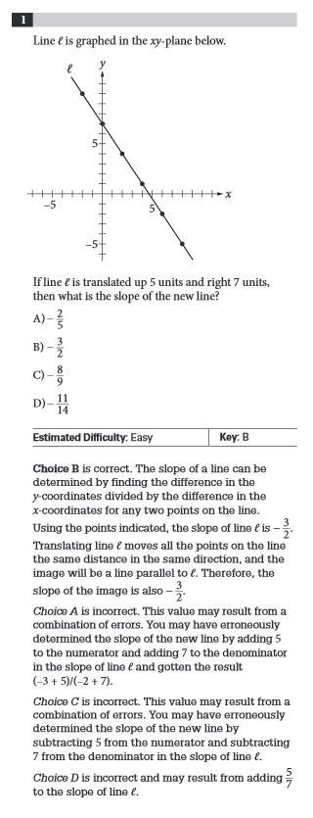
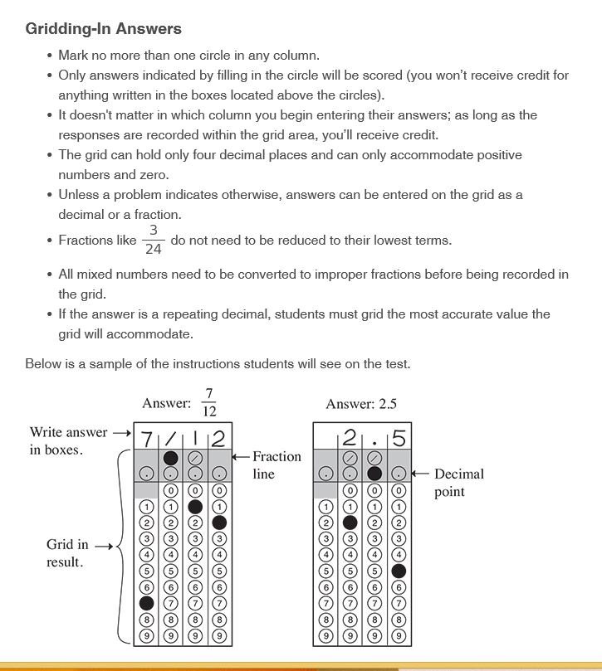
Take a look:
Multiple Choice
Grid In
https://collegereadiness.collegeboard.org/samplequestions/math

Slide 20
 | Content Emphasis-Features | Question Type- Expectation | # - Time Allotted
The Essay | Reading: A successful essay shows that you understood the passage, including the interplay of central ideas and important details. It also shows an effective use of textual evidence. Analysis: A successful essay shows your understanding of how the author builds an argument by: Examining the author’s use of evidence, reasoning, and other stylistic and persuasive techniques Supporting and developing claims with well-chosen evidence from the passage Writing: A successful essay is focused, organized, and precise, with an appropriate style and tone that varies sentence structure and follows the conventions of standard written English. | Entire passage is given for reading. Prompts are listed in which students need to consider how the author uses: Evidence, such as facts or examples, to support claims Reasoning to develop ideas and to connect claims and evidence Stylistic or persuasive elements, such as (word choice or appeals to emotion) to add power to the ideas expressed Analyze how the author uses one or more of the features in the directions that precede the passage (or features of your own choice) to strengthen the logic and persuasiveness of the argument. SHOW NOT WHETHER YOU AGREE OR DISAGREE WITH THE AUTHOR’S CLAIMS, BUT EXPLAIN HOW THE AUTHOR BUILDS AN ARGUMENT TO PERSUADE HIS OR HER AUDIENCE. | One Essay 50 Minutes (time to develop)

Slide 21
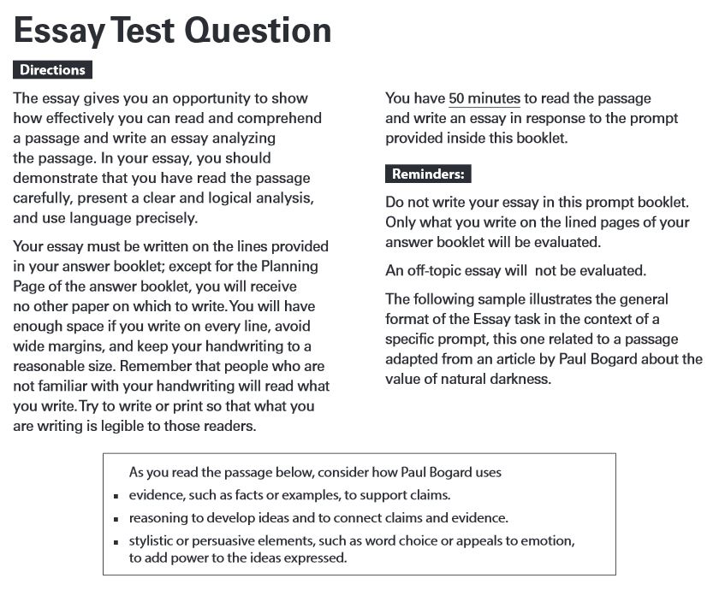
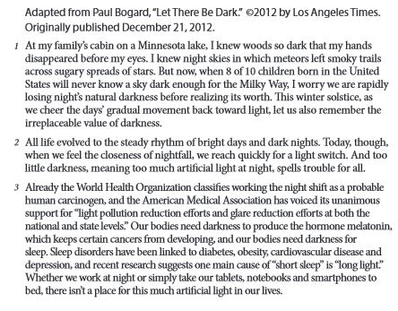
Take a look:
Passage-based
Analyze Author
Draft & Write
https://collegereadiness.collegeboard.org/sample-questions/essay

Slide 22
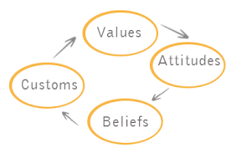
Essay passages examine ideas, debates, trends, and the like in the arts, the sciences, and civic, cultural, and political life that have wide interest, relevance, and accessibility. The passages tend not to be simple pro/con debates on issues but instead efforts to convey nuanced views on complex subjects.

Slide 23
Start to create and commit to your own prep plan now! A little bit a day does make a difference.

Slide 24
One Stop Shopping
Go to http://www.keweenawtrio.org/
2. Pull down the College Corner Bar and download this entire presentation and
all its links under Redesigned SAT. http://www.keweenawtrio.org/sat-resources
3. Find links on the page around RESOURCES,PREPARATION, AND SKILL BUILDING.
Contact us with any questions or concerns at http://www.keweenawtrio.org/contact-us/

Slide 25
SLIDES BELOW ALL FOR EXTRA TIME AND MORE IN DEPTH

Slide 26
TIPS FOR THE READING TEST:
All questions are passaged-based and require you to use the information-evidence given (not prior knowledge). Don’t be mislead by an answer that looks correct, but is not supported in the text.
Read carefully (Let questions guide you, while knowing your own reading skills). The answer will always be, or be implied in the passage or informational graphic.

Slide 27
More Reading Tips:
Questions generally start around the theme or central ideas, move to point of view, and then to text structure. (*Daily article practice/English response?)
Stay with a passage until you have answered as many questions as you possibly can. Don’t jump around. REMEMBER ALL QUESTIONS ARE WORTH THE SAME POINTS AND NO PENALTY FOR GUESSING.
Mark up your test booklet. Underline keywords and points. Circle phrases that relate to questions.
Build up reading stamina starting now reading articles and essays!

Slide 28
TIPS FOR THE WRITING-LANGUAGE TEST:
Read each passage carefully.
See yourself in the role of someone revising and editing text to improve text: -development -organization -and expression of information and ideas
Correct errors in sentence structure, usage, and punctuation. Think like an
English teacher grading student papers. Go for CLEAR and CONCISE.

Slide 29
Some questions have you find the evidence in a specific line. (REFER)
Others seek the writer’s overall purpose/approach. (INFER)
Recognize the difference. Finding the best answer may
require looking earlier or further ahead in the passage.
Select “NO CHANGE” if you think the original version is the best option.
(About 20% of the time or around1 in 5)
Stay with a passage until you have answered as many questions as you can. Mark skipped ?s so that you can go back to if you have time.
Make notes. Draw on graphs or charts if needed. (Scrap paper w/KHAN)

Slide 30
TIPS FOR THE MATH TEST:
You do not have to memorize formulas. Commonly used formulas are provided.
Read the problem carefully. Look for key words that tell you what the problem is asking. Ask yourself the following questions:
What is the question asking?
What do I know?
Draw a sketch or diagram of the given information as needed.
Don’t try to do it in your head. Test booklet is for scratch work.
Use the Process of Elimination (POE)
Lots of data analysis with charts, graphs, tables (Again Critical thinking)
*Have calculator/paper when on KHAN

Slide 31
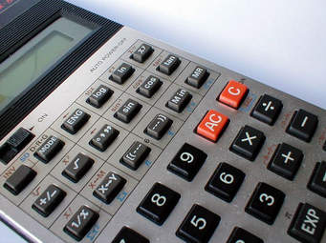
Bring a calculator, even if you're not sure if you will use it.
Don't try to use a calculator on every question. First, decide how to solve the problem, and then decide whether to use the calculator. The calculator is meant to aid you in problem solving select questions, not to get in the way.
Get your thoughts down before using your calculator.
Make sure your calculator is in good working order and that batteries are fresh. If your calculator fails during testing and you have no backup, you'll have to complete the test without it.
https://sat.collegeboard.org/register/calculatorpolicy

Slide 32
TIPS FOR THE ESSAY:
Explain how the passage’s author builds an argument to persuade an audience.
Analyze the passage for the author’s use of:
evidence
reasoning
stylistic and/or persuasive elements
and/or other persuasive features
*Imagine you are having a cup of coffee with the author and could ask him or her about the language choices he or she has made. Elaborate!

Slide 33
Base your essay on the features of the passage most relevant to responding to the prompt. ORGANIZE IDEAS IN A DRAFT!
Your response should not focus on whether you agree or disagree with the claim made in the passage, but should instead focus on how the author builds an argument to persuade an audience.
Read sample student essays: https://collegereadiness.collegeboard.org/sample-questions/essay/1

